Slide 1
A SUBMISSION (Part)
-
(REF.WPMV7HP)
TO THE
HEALTH SELECT COMMITEE
HEALTH (FLUORIDATION OF DRINKING WATER
AMENDMENT BILL No. 208-1).
(Against this Bill and why!)

Slide 2
THE DATA FOR THIS PRESENTATION IS SOURCED FROM;
THE WORLD HEALTH ORGANISATION (WHO).
THE USA HISTORY OF FLUORIDATION FILES.
EARLY AND VARIOUS USA REPORTS
JOURNALS OF THE AMERICAN DENTAL ASSOCIATION.
JOURNALS OF THE AMERICAN MEDICAL ASSOCIATION.
THE INTERNATIONAL NIOSH HEALTH & SAFETY DATABASE.
THE UNESCO UNIVERSAL DECLARATION – BIOETHICS AND HUMAN RIGHTS.
THE WORLD’S PRESTIGOUS ‘LANCET’ MEDICAL JOURNAL.
THE AAAS – AMERICAN ASSOCIATION FOR ADVANCEMENT OF SCIENCE.
Dr DEAN BURK (PhD) of NATIONAL CANCER INSTITUTE (USA).
. NFPA, DOCTORS, UNIVERSITIES, and More .......... SHOWING ..........

Slide 3
NEW ZEALAND
HAS BEEN
CONNED
AND WORSE!

Slide 4
NO MATTER WHO YOU ARE
THIS SERIOUS PROBLEM EFFECTS US ALL – NO MATTER YOUR STATUS, RACE OR BELIEFS.
IT IS EFFECTING EVERYONE’S LIFE NOW AND MORE SO AS TIME GOES ON.
THIS PROBLEM IS MAN-MADE AND BASED ON BOTH IGNORANCE AND GREED.

Slide 5
Our Government and Local council officials have really failed us.
Govt officials have been manipulated by overseas big business and now here in NZ.
Both central and local government did not do any proper research on this matter.
Govt is planning to continue in destroying ALL our health and lives through their ignorance.

Slide 6
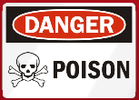
FORGET ABOUT KID’S DENTAL HEALTH
FOR A MOMENT –
THERE IS A MUCH BIGGER DANGER
THAT EFFECTS US ALL.
WE ARE ALL TO BE SLOWLY POISONED.

Slide 7
WHY WAS ‘FLUORIDATION’ EVER STARTED IN THE FIRST PLACE?
WHY WAS FLUORIDE CHOSEN AS THE MEDIUM
AND NOT SOMETHING ELSE?
HISTORY PROVIDES THE ANSWER.
‘BIG BUSINESS’ HAD A PROBLEM.
BUT
IF THEY COULD ‘CON’ PEOPLE INTO BELIEVING
THEY WERE PROVIDING A HEALTH BENEFIT,
THEY WOULD BE HAPPY & SUCCESSFUL.

Slide 8
This ‘Big Con’ started in America!
THERE WAS A MASSIVE AMOUNT OF TOXIC WASTE BEING PRODUCED AS AMERICA DEVELOPED THE ATOMIC BOMB FOR DEFENCE PURPOSES.
(Hiroshima and Nagasaki bombed 1945)
THE AMERICAN GOVERNMENT BACKED THESE INDUSTRIES BUT THERE WERE SOME ‘UNUSUAL ACTIVITIES’ THAT WENT ON BEHIND THE SCENES.
INDUSTRY ALSO HIRED ‘THE BEST IN THE FIELD’ OF PUBLICITY AND HUMAN RELATIONS ‘PR EXPERTS’ TO ACHIEVE THEIR ‘PLAN’ – WHY?

Slide 9
This ‘Big Con’ in America!
Their aluminium industry had a industrial site problem disposing of their massive toxic waste.
Their toxic waste was very expensive to legally dispose of (even back in 1945) due to USA laws. They were being sued by many neighbours – trees and toothless cattle, dying over hundreds of acres.
Bureaucrats hatched a really clever ‘plan’ to sell this waste to local cities and towns as a ‘health benefit’.
With very heavy TV & ‘sales pitches’ ( without tests or proof) they convinced nearly all USA councils to buy their product as a dental care solution!!!
(Their ‘CREST’ toothpaste adverts - real examples of ‘brainwashing of the masses’.)

Slide 10
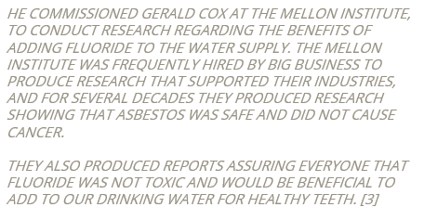
A FEW YEARS LATER, ONE EXTRACT FROM AN EARLY USA REPORT:
MR FRANCIS FRARY, CHIEF SCIENTIST WITH THE ALUMINIUM COMPANY – ALCOA , DEVISED ‘A PLAN’ TO SOLVE THEIR TOXIC WASTE DISPOSAL PROBLEM.

Slide 11
TWO ITEMS THEY KNEW EVEN BACK THEN
BEFORE THEIR BIG CON!
The Medical Consensus on Fluoride Prior to 1945
Item 1.
For example, a 1936 issue of the ‘Journal of the American Dental Association’ stated that fluoride at the 1 ppm (part per million) concentration is as toxic as arsenic and lead.
Prior to 1945 when communal water fluoridation took effect, fluoride was a known toxin. They were using it in
both their rat and cockcroach control pesticides.

Slide 12
Item 2.
The ‘Journal of the American Medical Association’ stated in their September 18, 1943 issue, that fluorides are general protoplasmic poisons that change the permeability of the cell membrane by certain enzymes.
And, an editorial published in the Journal of the American Dental Association, October 1, 1944, stated:
"Drinking water containing as little as 1.2 ppm fluoride will cause developmental disturbances. We cannot run the risk of producing such serious systemic disturbances. The potentialities for harm outweigh those for good."
THIS WAS ALSO BEFORE THE BIG FLUORIDE ‘CON’ STARTED
AND ALL WAS COMPLETELY IGNORED BY ‘BIG BUSINESS’.

Slide 13
TWO IMPORTANT NOTES.
Note 1.
Internationally, most countries have banned fluoridation because of health concerns and because of human rights considerations.
These countries include Japan, Scotland, Northern Ireland, China, Russia, Germany, Netherlands, Norway, Israel, Sweden, Austria, Belgium, Denmark, Finland, France, Croatia, Estonia, Greece, Hungary, Latvia, Switzerland, Luxembourg and the Czech Republic.

Slide 14
Note 2.
Notably the practice of fluoridating water supplies appears to breach the UNESCO Universal Declaration on Bioethics and Human Rights (2005), to which NZ is a signatory (along with around 160 other countries) and in particular,
Article 6 which states that -
"in no case should a collective agreement or the consent of a community leader or other authority, substitute for an individual’s informed consent".
NZ Govt activity and current proposal - HAZARDOUS, Blatantly unethical! ILLEGAL?

Slide 15
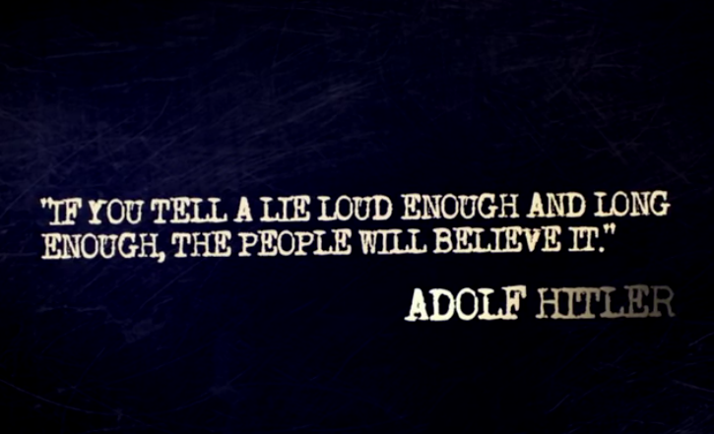
THE NZ DENTAL ASSOCIATION, THE NZ HEALTH DEPARTMENT, AND OTHER OFFICIALS WE TRUSTED
HAVE ALSO BEEN TELLING US FLUORIDE IS SAFE
AND THEY RECOMMEND IT.
HE ALSO BELIEVED IN ‘BRAINWASHING’ AND ‘MASS MEDICATION’ OF PEOPLE!

Slide 16
THE PRODUCT IS – ‘FLUORIDE’ - ADDED TO SOME LOCAL WATER SUPPLIES.
BUT, HERE IS ONLY A PART-LIST OF SOME OF THE WISER NATIONS.
WESTERN EUROPE – 97% REJECTED IT, BANNED OR STOPPED FLUORIDATION.
CHINA – BANNED IT – NOT ALLOWED – (BUT NOW SELLS A VERSION TO USA)!!!!
AUSTRIA – REJECTED IT - NOT ADDED.
BELGUIM – REJECTED IT – THOSE WANTING IT, TO GET IT THEMSELVES.
DENMARK – AGAINST FLUORIDATION.
FINLAND – STOPPED IT – NO ADEQUATE STUDIES.
GERMANY – STOPPED - NO EVIDENCE OF A BENEFIT.
HUNGARY – STOPPED – REMAINS UNFLUORIDATED,
JAPAN – REJECTED – MAY CAUSE HEALTH PROBLEMS.
(THINK OF ALL THESE EDUCATED MULTI-MILLIONS OF WISE PEOPLE)
FACT: ONLY 5% OF THE WORLD IS FLUORIDATED AND OVER 50% OF THESE PEOPLE WITH FLUORIDATED WATER, LIVE IN AMERICA!
(NO PRIZE FOR GUESSING WHERE THERE ARE SOME OTHER ‘SHEEP’ TYPE CUSTOMERS!)

Slide 17
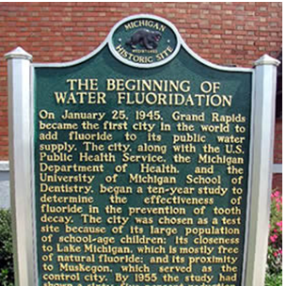
GRAND RAPIDS, MICHIGAN, WAS THE FIRST U.S.A. CITY TO FLUORIDATE – 1945.
PEOPLE BELIEVED IN WHAT THEY WERE TOLD REPEATEDLY IN PROMOTIONS ON THEIR THEN NEW BLACK & WHITE TVs.

Slide 18
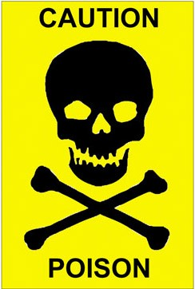
MOST PEOPLE DON’T REALIZE
There are three Fluoride types:
Sodium fluoride - A natural substance found
in some countries in rock formations.
2. Sodium silicofluoride (Used in U.S.A. in water as the base of fluoridation, tests, and in many toothpastes.)
3. Hydrofluorosilic acid (Added to NZ water supplies
(INVOLVED WITH WATER SUPPLIES)
- untested).
When ‘fluoride’ is added to your NZ drinking water, it’s NOT the natural fluoride, nor a pharmaceutical grade fluoride. Instead, the fluoride in question is another chemical fluoride compound – the ‘most toxic’ waste product - from phosphate fertilizer plants.

Slide 19
THE THREE FLUORIDES HAVE DIFFERENT CHARACTERISTICS OR HAZARDS.
EXAMPLES:
THEIR SOURCE LOCATION VARIES – NATURAL OR MAN-MADE
THEIR TOXICITY VARIES WIDELY – ‘NATURAL’ IS THE LOWEST.
(and NZ’s fluoride type is the highest.)
THEIR HUMAN ABSORPTION RATES VARY WIDELY.
PART OF THEIR ‘CON’ WAS TO TALK ABOUT AND RUN TESTS ON A LESS TOXIC ONE,
BUT SUPPLY ANOTHER – THE MORE TOXIC ONE THEY WANTED RID OF !

Slide 20
FLUORIDE FACTS
FLUORIDE IN OUR NZ FLUORIDATION IS A MAN-MADE SUBSTANCE FROM FACTORY TOXIC WASTE.
IT CANNOT JUST EFFECT TEETH ONLY, IT EFFECTS ALL OF YOUR ORGANS WHEN INGESTED VIA WATER.
IT IS EXTREMELY TOXIC AS INTERNATIONAL OFFICIAL DATA SHOWS.
IT REQUIRES EXTREME SAFETY PROCEDURES FOR ITS STORAGE AND TRANSPORT.
NZ EMERGENCY SERVICES USE AN INTERNATIONAL DATABASE OF SAFETY PROCEDURES TO COPE IN EMERGENCIES.

Slide 21
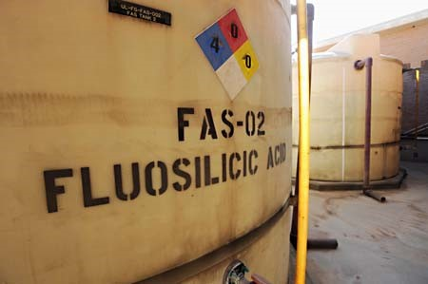
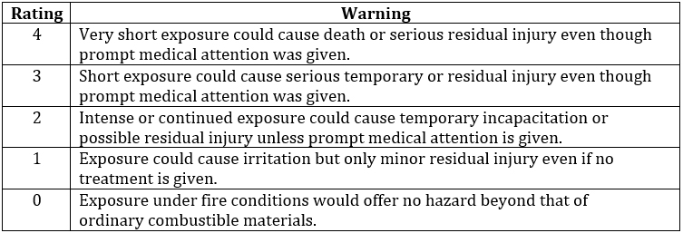
ALL CHEMICALS HAVE AN OFFICIAL HEALTH HAZARD RATING SIGN.
STORED OR BULK FLUORIDES HAVE THE NUMBER 3 0R 4 RATING.
AS SHOWN IN PHOTO’S 4 COLOURED DIAMOND OF HAZARD DATA.

Slide 22
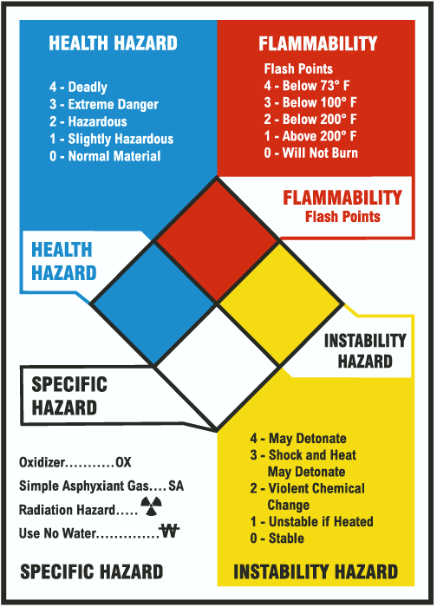
THE NFPA SAFETY DIAMOND
(NATIONAL FIRE PROTECTION ASSN.)
(AS DISPLAYED ON CHEMICAL SITES.)
USED INTERNATIONALLY FOR EMERGENCY RESPONSES.
A NUMBER IS IN EACH COLOURED DIAMOND THAT RELATES TO THE HAZARD OF THE CHEMICAL INVOLVED.
FLUORIDE WILL HAVE THE NUMBER 3 OR 4
IN THE BLUE DIAMOND INDICATING THE LEVEL OF
THE HEALTH HAZARD.
4 = DEADLY
3 = EXTREME DANGER.
AND WHO SAID FLUORIDE IS SAFE?
(All Part of the big CON!)
4

Slide 23
THE NIOSH INTERNATIONAL SAFETY CHEMCARD:
(National Institute of Occupational Safety & Health)
FOR FLUORIDE (HYDROFLUOROSILIC ACID) – (AS USED IN NZ.)
EACH CHEMICAL IS GIVEN IDENTIFICATION NUMBERS TO ASSIST IN EMERGENCIES.
THESE ARE OFTEN IN THE FORM OF U.N. NUMBERS AND FLUORIDE IS U.N. 1778.
ON THE FLUORIDE CHEMCARD IS LISTED FLUORIDE’S DATA AS:
EXPOSURE – AVOID ALL CONTACT. (Full chemical suits & CA Breathing sets required.)
FIRST AID & FIREFIGHTING – In all cases consult a doctor.
ROUTES OF EXPOSURE – Can also be absorbed into the body by inhalation or ingestion.
EFFECTS OF SHORT TERM EXPOSURE – The effects may be delayed.
EFFECTS ON LONG TERM EXPOSURE – The substance may have effects on bones
and teeth resulting in fluorosis.

Slide 24
WHAT ARE FLUORIDE’S MAIN DANGERS?
THE EFFECTS ARE ACCUMULATIVE IN YOUR BODY – IT WORSENS AS YOU GROW OLDER.
IT EFFECTS OUR BRAINS AND MENTAL CAPABILITIES.
IT EFFECTS YOUR THYROID – THE GLAND THAT CONTROLS MANY OF YOUR BODY’S FUNCTIONS.
IT DETERIORATES YOUR BONES SLOWLY.
IT EFFECTS / RAISES YOUR BLOOD PRESSURE.
NEW STUDIES ALSO LINK IT TO CANCER INCREASES.

Slide 25
U.S.A. IS THE MOST FLUORIDATED COUNTRY
BUT in 2016 ……..
According to an estimate by endocrinologists, more than 40 percent of the U.S. population are now affected on some level by low thyroid function, also known as hypothyroidism. This condition is actually an autoimmune disease, which also makes over 80 percent of conventional pharmaceutical treatments (pills) ineffective.
Also worth noting is the fact that between 1975 and 1996 the incidence of thyroid cancer has risen 42.1 percent in the fluorinated U.S.A.
FACT: Thyroid hormones are necessary for normal health and cellular activity, and if thyroid function is not normal, weight loss is also next to impossible – obesity.
Are we seeing NZ citizens suffering the same problems?

Slide 26
NEW reports on the Water Fluoridation ‘Con’.
The Product Was Switched.
They talked about one but supply another. Their tests and reports are NOT based on the one supplied.
NZ’s Hydrofluorosilic acid (Fluoride)is one of the most reactive chemicals known to man. Its toxicity is rather well known in chemical circles. It will eat through metal and plastic pipes, and corrode stainless steel and other materials. It will dissolve rubber tires and melt concrete. This is what they ‘drip feed’ into your NZ water – all in their name of saving some children from dental cavities!
(And ignoring the damage to everyone’s other organs.)

Slide 27
FLUORIDE
CAN BE SUPPLIED UNDER DIFFERENT TYPE NAMES BUT ALL ARE STILL FOREIGN TO ANY HUMAN BODY AND A REAL TOTAL HEALTH RISK.
THE QUALITY OF THE FLUORIDE SUPPLIED ALSO VARIES (especially if from China – as it was in Invercargill City, NZ, 1990 incident.)
THE DOSAGE YOU GET, CANNOT BE CONTROLLED AS YOUR LIFE’S EXPOSURE TO FLUORIDE CAN DIFFER WIDELY – (WATER CONSUMED, SKIN ABSORBTION, PROCESSED FOOD EATEN, ETC).
(Only 0.03% of Fluoride will effect a body’s functions!)
(‘Journal of Epidemiology & Community Health’ – Research Group.)

Slide 28
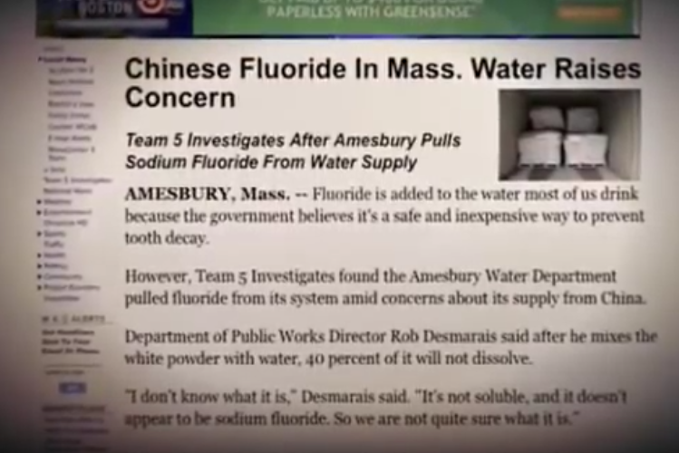
EVEN IN AMERICA THE QUALITY CANNOT BE RELIED ON!

Slide 29
TOXIC FLUORIDE EXPOSURE
Fluoride exposure comes from public network tap water, most toothpaste and many antibiotics, including ones given to farm animals (our food supply).
There is a large variation in exposure levels, making it impossible to accurately predict the exposure for any one person, family, or community.
Fluoride exposure for many, can easily reach danger levels.
For example, Poison control should be called if anyone swallows a quarter milligram of fluoride from toothpaste.
(Sodium Fluoride is listed with the U.N. Number 1690 - toxic.)

Slide 30
HOW IS YOUR FAMILY’s EXPOSURE?
While its being added into our water supply TOXIC FLUORIDE can also be slowly ABSORBED
via everything involving water:
DRINKING – your coffee, tea, some bottled water, cordials, etc. (Hot or thirsty athletes to beware!)
Ingested water effects your immune system (80% in gut).
INGESTION – from food – watered plants, washing, cooking, and from in the processing of many foods.
SKIN CONTACT – some toiletries, toothpaste, and our skin is our biggest organ absorbing chemicals easily.
BATHING – showering, baths, and pool swimming.
WASHED items – from bedding, clothing, etc. over time.
(Note: You cannot get rid of Fluoride just by ‘boiling’ your water.)

Slide 31
WHAT ARE OUR HEALTH RISKS?
FLUORIDE is slowly ACCUMULATIVE AS TIME PASSES!
NEW dental research now shows Fluoride provides NO real benefits, (see next graph) and there are better, safer, natural dental care alternatives available here in NZ.
THYROID gland damage – this gland controls your functions and organs and many people are having massive problems. Hospitals and medical services are becoming overloaded! Tired Staff! Appointments can take weeks!
BONES & JOINTS – your bones denied normal nutrients – leads to decay, deformity, collapse, or surgery.
CANCER INCREASE – this fluoride toxin adds to those toxins already causing skin and other cancers.

Slide 32
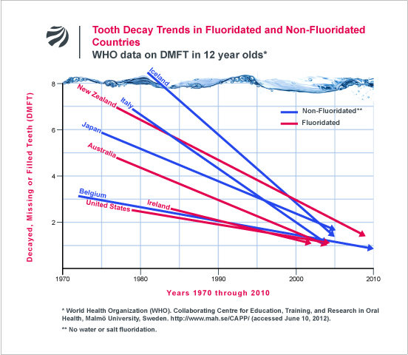
JUST SOME OF THE OFFICIAL PROOF FLUORIDE IN WATER IS LITTLE OR NO BENEFIT WHEN COMPARING COUNTRIES.

Slide 33
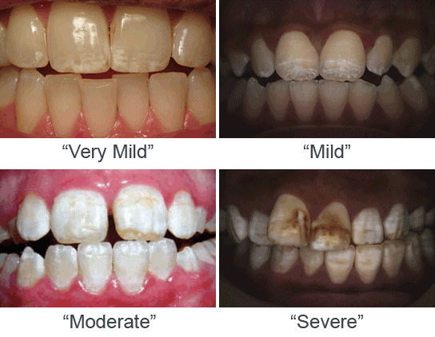
VISUAL DENTAL INDICATIONS OF EXCESS FLUORIDE ACCUMULATION IN TEETH (the only ‘exposed’ human bones).
Above: Stages of Dental Fluorosis
Image credit: FAN (FluorideAlert.org)
BUT INTERNALLY IT GETS WORSE .........

Slide 34

Skeletal fluorosis is the result of years of fluoride accumulation. The World Health Organization now confirms it can lead to changes in bone structure.
Excessive fluoride intake can also lead to joint pains, stiffness, collapse, or replacement surgery.

Slide 35
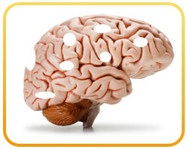
Our Brains are also at risk!
Evidence is now available that Fluoride has a bad effect on children - the IQ of students and smaller young brains – increased Autism, ADHD, Depression.
There is also a link to the decline in the brain function of elderly people from the accumulation of FLUORIDE in their body’s system over their life’s years.
(Forgotten people’s names, your keys, etc, more lately?)
Do/will they just tell you it’s age related - to conceal it?

Slide 36
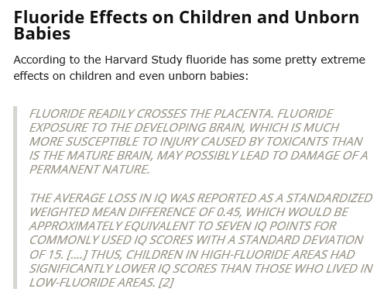

Slide 37
The CDC (Centre Disease Control) and the ADA of USA Warn Against Fluoridated Water for Infants.
In November 2006, the ADA (American Dental Association)
sent out an email to its members, recommending parents to use non or low-fluoride water to make infant formula.
This was a very reasonable recommendation, because an average glass of fluoridated water contains 250 times more fluoride than breast milk.
A few days later, the Centre for Disease Control (CDC) followed suit, but, neither of them openly warned the public.
Were we in NZ warned? NO. WHY not? Who failed us?

Slide 38
New Zealand age structure
Otago Polytechnic.
As of the beginning of 2017 according to our estimates New Zealand had the following population age distribution:
In absolute figures (estimate):
932 872 young people under 15 years old ( 478 061 males / 454 810 females)
20.4% of population under 15.
3 037 439 persons between 15 and 64 years old (1 521 878 males / 1 515 561 females)
66.4% of population.
606 627 persons above 64 years old ( 277 866 males / 328 807 females)
13.3% of population.
EVEN IF ONLY 20 % OF THE POPULATION IS THEIR TARGET GROUP, WHY FORCE TOXIC FLUORIDE ON THE OTHER 80% OF US?
THERE ARE OTHER AND BETTER ALTERNATIVES.

Slide 39
How much Fluoride is a danger?
The Journal of Epidemiology & Community Health test found the health risk starts at 0.3 milligrams per litre of water.
Auckland Council has just recently lowered the input dosage down to 0.7 which is still double of the risk maximum exposure limit.
What was it before? How much have you already accumulated? Will this continue?
(Annual costs of Auckland fluoridation approx $210,000 – to poison the citizens!!!!).

Slide 40
HAVE YOU NOTICED?
NZ Dental industry is focused only on children’s dental problems and wants to put more Fluoride in our kids’ toothpaste ignoring the other serious HEALTH risks.
The Fluoride WARNING on some packets of toothpaste. Do READ them carefully. Poison! Actions if any swallowed! Contact the Poison Centre! What is that telling us???
The NZ Dental industry wants to increase the dose levels!
They do not realize or know why that won’t work (we know the tech reason) but, it becomes a bigger danger to everyone!
BE AWARE -TOOTHPASTE WARNINGS IN NZ ARE NOT COMPULSORY, AS IN USA.

Slide 41
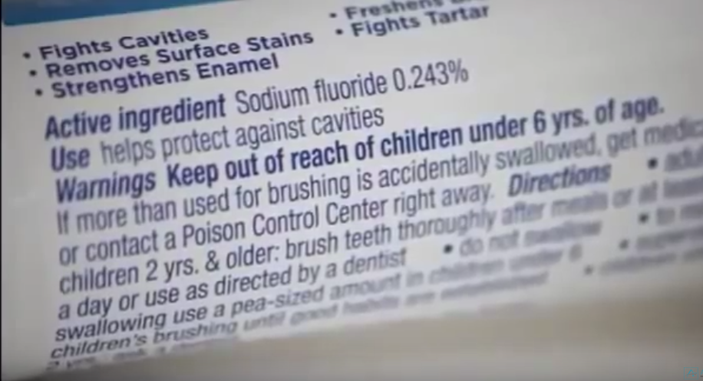
READ A SAMPLE OF FLUORIDE WARNINGS ON TUBES OF U.S.A.
‘FLUORIDE’ TOOTHPASTE. LOOK AT THE PER CENTAGE %.
BUT in NZ -‘Colgate Total’ = 0.32% and ‘MacLeans’ = 0.35%. WHY?
(Sodium Fluoride has the U.N. Number 1690 - toxic.)
‘CONTACT A POISON CENTRE RIGHT AWAY’ SHOULD BE TELLING US SOMETHING!

Slide 42
OUR HEALTH SERVICES ARE NOT COPING WELL AND THE COSTS ARE SOARING.
AS TIME GOES BY MORE OF US ARE SUFFERING FROM THYROID PROBLEMS, BRAIN PROBLEMS, BONE AND JOINT PROBLEMS, AND MORE CANCERS, JUST NAMING SOME.
THE HAZARDOUS EFFECTS OF FLUORIDE ARE RELATED DIRECTLY TO THESE SERIOUS PROBLEMS.
(ANOTHER FLUORIDATED COUNTRY IS ALSO SUFFERING THE SAME HEALTH PROBLEMS)
NEW RESEARCH HAS NOW FOUND THE REAL REASON WHY WE NEVER KNEW AND THE INFORMATION WAS AVAILABLE SOME YEARS AGO.
IT WAS HIDDEN FROM THE PUBLIC, BY CERTAIN ORGANISATIONS AND OFFICIALS.
THE INFORMATION REPORTS HAVE NOW BEEN REDISCOVERED AND NOW AVAILABLE.
THEIR ACTIONS WERE/ARE MORALLY WRONG, IF NOT CRIMINAL !

Slide 43
ONE HIDDEN ANNOUNCEMENT - 2006
IN THE WORLD’S TOP PRESTIGOUS MEDICAL JOURNAL
‘THE LANCET’
IT HAD BEEN FORMALLY ANNOUNCED THAT
FLUORIDE HAD BEEN DECLARED A NEUROTOXIN. (BRAIN DAMAGING)
THE ‘REPORT’ GROUPS FLUORIDE WITH OTHER NEUROTOXINS
SUCH AS ARSENIC AND LEAD .
(The detailed report can be read on-line)

Slide 44

ANOTHER REPORT:
The report coincides with 2013 findings by a Harvard University meta-analysis funded by the National Institutes of Health that concluded that children in areas with highly fluoridated water have “significantly lower” IQ scores than those who live in areas with low amounts of fluoride in their water supplies.
There are numerous other new reports too.
One report advises ‘diabetic’ people are particularly ‘at risk’.

Slide 45

LATEST REPORT ON AMERICAN’S CURRENT MENTAL HEALTH STATUS (Dec. 2016). (Source - Dr. Mecola.com)
1 in 6 Americans Are Now on Psychiatric Medication
Drug Corporations are smiling in USA–
the biggest most fluoridated country
In the world.
Story at-a-glance
1 in 6 Americans are now on antidepressants or some other type of psychiatric drug,
and most appear to be taking them long-term
Caucasians are twice as likely to use psychiatric drugs than African-Americans and Hispanics;
1 in 4 seniors are taking at least one psychiatric drug; and nearly twice as many women use psychiatric drugs than men
While psychiatric drug prescriptions have increased, mental health in the U.S. is declining.
Suicide rates are at a 30-year high and mental disorders are now the second most common cause of disability.
WILL NEW ZEALAND FOLLOW SUIT? THE POSSIBILITY IS VERY REAL IF FLUORIDATION IS NOT CEASED BUT FORCED ON US ALL TOO.

Slide 46
NEW ZEALAND TV1 NEWS
23-01-2017
THE GOVERNMENT ESTIMATES THERE ARE 60,000 PEOPLE
IN NEW ZEALAND SUFFERING FROM DEMENTIA.
THEY ESTIMATE IT WILL TRIPLE BY 2030.
------------------------------------------------------
THE PROBLEM IS NOT HELPED BY THE INGESTION OF FLUORIDE ADDED TO ALL WATER.
THE COST OF COPING WILL ESCULATE WITH THE NUMBERS OF PEOPLE SUFFERING, FAMILIES STRESSING, AND OVERWORKED CARERS.
THIS IS NOT ACCEPTABLE.

Slide 47
The World Health Organization (WHO) reports Jan 2017
that around 47 million people around the world suffer from
dementia, and 7.7 million new cases emerge every year.
The threat is definitely growing, and there have to be
reasons for it; nearly anyone might argue it has something
to do with the environment.
---------------------------------------------
Another valid reason to remove toxins such as Fluoride
from our water supplies.
Those who still want Fluoride could still buy it in toothpaste and most technical people agree, any benefit from Fluoride is
best from topical (direct) applications – not ingested.
Government’s money saved, could support better dental care for those most needy.

Slide 48
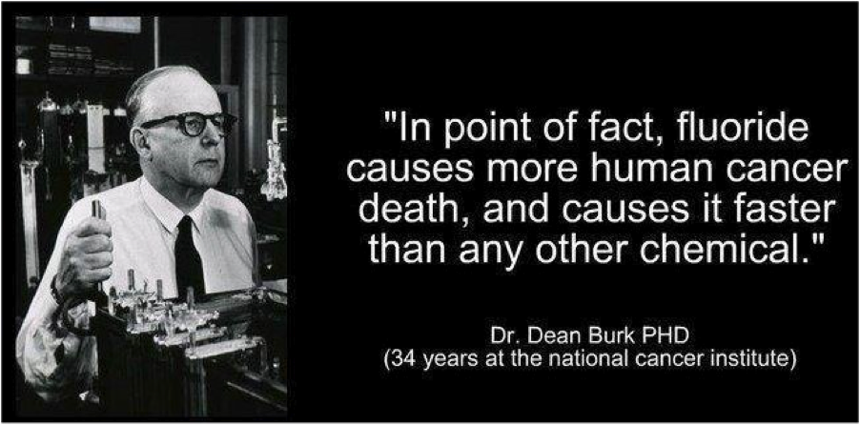
FLUORIDE AND CANCER!
THIS INFORMATION WAS ALSO AVAILABLE TEN YEARS AGO !

Slide 49
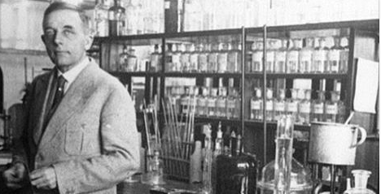

ALSO:
Noble prize Winner Dr. Otto H Warburg, who discovered the real cause of cancer,
has found that the root cause of cancer is oxygen deficiency. Oxygen deficiency
leads to an acidic state in the human body. Dr. Warburg also found that cancer cells
are anaerobic (do not breathe oxygen) and cannot survive in the presence of high
levels of oxygen, as found in an alkaline state.
-------------------------------------------------------
By enforcing that FLUORIDE (Hydrofluorosilic Acid) be added to our NZ water supplies increases our exposure, increases your body’s acidic state and your family’s risk of CANCER.
THEN, comes the danger of sugar (glucose) in our western diet, medically known to be the food of cancer!

Slide 50


ANOTHER SERIOUS QUESTION!
THE NUMBER OF PEOPLE SUFFERING OR DYING FROM CANCER IS INCREASING.
THERE ARE A RANGE OF POSSIBLE CAUSES, BUT.......
IF YOU OR ANYONE GETS, HAS, OR HAD CANCER, HOW CAN THEY BE EXPECTED TO RECOVER WHEN SOME ‘PUPPETS’ ARE STILL PUTTING ‘CANCER PROMOTING’ FLUORIDE INTO THE WATER SUPPLY?
(Particularly if chemotherapy was in their treatment.)
WHO WILL CARRY THE GUILT IN THE FUTURE?
THINK SERIOUSLY ABOUT THAT!

Slide 51
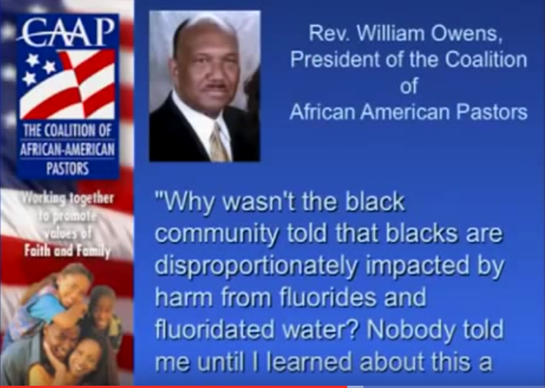
FACT - SOME RACES WITH A DIFFERENT GENE ARE EFFECTED WORSE BY FLUORIDE

Slide 52
THESE HAZARDS OF FLUORIDE.
WHO KNEW BUT NEVER PASSED IT ON? A REAL COVERUP?
WHY WERE YOU NOT TOLD ABOUT THESE SERIOUS HAZARDS?
WHY WERE WE NOT TOLD THROUGH THE NEWS / TV MEDIA?
WHO IS RESPONSIBLE? A GOOD CASE FOR A ‘CLASS ACTION’?
WHO IS MAKING ALL THE MONEY OUT OF FLUORIDE?
(Following the money trail usually reveals the villains.)
WILL IT BE STOPPED OR JUST CONTINUE, AT OUR EXPENSE?
UNFORTUNATELY, ONE MINISTER OF HEALTH (WHO WE TRUSTED) BELIEVES IN PUTTING FLUORIDE INTO YOUR WATER SUPPLY – WITH LITTLE RESPONSE FROM OUR NAIVE PUBLIC – SO FAR.

Slide 53
TO UNDERSTAND THE PROBLEM AND PROVIDE A SOLUTION.
FIRSTLY, WE NEED TO SEPARATE THESE TWO ITEMS -
FLUORIDATION – THE ACT OF PUTTING FLUORIDE INTO WATER SUPPLIES.
(THE ACT OF FLUORIDATION CAN BE STOPPED OR STARTED AT ANY TIME.)
2. FLUORIDE – THE ACTUAL FLUORIDE SUBSTANCE ITSELF WITH ITS CHEMICAL PROPERTIES.
(FLUORIDE AND ITS CHEMICAL PROPERTIES CANNOT BE CHANGED – IT IS ALWAYS TOXIC.)
SOLUTION = SIMPLY STOP ADDING FLUORIDE TO OUR WATER – USE ALTERNATIVES.
JUST HOW MUCH FLUORIDE EACH PERSON IS EXPOSED TO IS CRITICAL IN THIS WHOLE PROBLEM – BUT SIMPLY UNCONTROLLABLE AND UNNECCESARY.
WHILE IT IS BEING ADDED TO OUR WATER SUPPLIES LEAVES US WITH FEW OPTIONS
BUT..............

Slide 54
THERE ARE ‘ALTERNATIVES’ AVAILABLE - MUCH BETTER THAN THE NEUROTOXIC AND POISONOUS FLUORIDE.
ONE ‘ALTERNATIVE’ DENTAL SOLUTION HAS THESE ADVANTAGES ;
IT IS NON-TOXIC AND NON-POISONOUS.
IT CONTAINS A NATURAL ANTISEPTIC FOR DESTROYING GERMS AND BACTERIA.
IT CONTAINS ESSENTIAL FATS FOR BRAIN TISSUE CELLS AND NEURONAL SHEATHS.
IT LOWERS LIPOPROTEIN CHOLESTEROL LEVELS IN THE BLOOD AND TISSUES.
IT LOWERS LIPOPROTEIN MARKERS FOR HEART ATTACKS.
IT HAS A PLEASANT TASTE ( WHICH IS ACCEPTABLE TO EVERYONE) WITHOUT RISK.
IT IS ECONOMICAL TO BUY, SIMPLE TO USE, (AND WITHOUT ANY DANGER WARNINGS).
IT DOES NOT NEED TO BE ADDED INTO OUR WATER SUPPLY & YOU DO HAVE A CHOICE.

Slide 55
More of the ‘Alternative’s detailed Benefits:
Antibacterial – stops bacteria that cause gum disease, throat infections, urinary tract infections and ulcers in their tracks.
Anticarcinogenic—keeps dangerous cancer cells from spreading while boosting immunity.
Antifungal—destroys infection-promoting fungus and yeast.
Anti-inflammatory—suppresses inflammation and repairs tissue.
Antimicrobial—inactivates harmful microbes and fights infection.
Antioxidant—protects from free radical damage.
Antiparasitic—can help rid the body of tapeworms and other parasites.
Anti-protozoa—kills protozoan infection in the gut.
Antiviral—helps to kill dangerous viruses that cause influenza, measles, hepatitis and more.
Why would anyone want to continue with the current toxic fluoride?

Slide 56
JUST SOME PROFESSIONALS WHO WERE PRO-FLUORIDE AND HAVE SINCE CHANGED THEIR MIND.
THE FORMER AUCKLAND PRINCIPAL DENTAL OFFICER WHO, ORIGINALLY HELPED PROMOTE FLUORODATION BOTH HERE AND OVERSEAS, HAS SINCE RESIGNED AND REVERSED HIS OUTLOOK ON FLUORIDE AFTER FURTHER STUDIES ON THE SUBJECT.
DOCTOR Richard L SHAMES MD and Karilee H. SHAMES PhD, RN, IN USA WHO WORKED AS A PREVENTION-ORIENTED TEAM FOR OVER 25 YEARS STUDYING THE EFFECTS OF FLUORIDE ON THE THYROID GLANDS. THEY WROTE SEVERAL BOOKS LIKE ‘THYROID POWER’. THEIR DEEP STUDIES ON THE HISTORY AND THE LACK OF TESTS HAD SHOCKED THEM. THEY ALSO DISCOVERED FLUORIDE IS THE ONLY ENVIRONMENTAL HORMONE DISRUPTOR THAT IS PURPOSELY ADDED INTO WATER SUPPLIES.
DOCTOR MERCOLA WHO DOES DEEP RESEARCH IN AMERICA INTO THE HISTORY OF FLUORIDATION AND HAS WRITTEN A BOOK EXCLUSIVELY ON THE SUBJECT WITH DATES, NAMES, AND PLACES INCLUDED. HE EXPLAINS HOW THE WHOLE THING WAS A LARGE PR STUNT AND HOW IT WAS CARRIED OUT TO SUIT A BUSINESS PLAN. HE EXPLAINS EVEN MORE ON HIS WEBSITE (MERCOLA.COM) WHICH HAS OVER 1.5 MILLION READERS.
AMERICA’S FLUORIDE ACTION NETORK (FAN) HAS MORE THAN 1000 SIGNATURES OF PROFFESSIONALS WHO ARE NOW ANTI-FLUORIDE AND THE NUMBER IS GROWING.

Slide 57
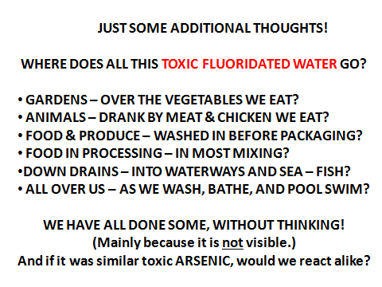

Slide 58
WE WILL GAIN EVEN MORE BY BANNING TOXIC FLUORIDE TOTALLY;
LESS PEOPLE SUFFERING BRAIN AND MENTAL PROBLEMS.
LESS PEOPLE SUFFERING JOINTS AND BONE PROBLEMS.
LESS PEOPLE SUFFERING THYROID AND ENERGY PROBLEMS.
WE WOULD ALSO GAIN;
REDUCTION IN DOCTORS OR SPECIALIST VISITS .
REDUCTION IN EXPENSIVE AND ALL MEDICATIONS.
REDUCTION IN MEDICAL AND SURGICAL OPERATIONS.
REDUCTION IN THOSE REQUIRING EARLY MEDICAL AND MENTAL CARE.
REDUCTION IN PAIN AND SUFFERING FOR EVERYONE INCLUDING CARERS.
OVERALL, WE CAN HAVE A MUCH BETTER LIFE - (AND ALL SAVE HEAPS OF MONEY!)

Slide 59
‘Toxicity and Deficiency Are Core Problems’
According to the American Association for the Advancement of Science (AAAS), preventable chronic diseases are now the world's biggest killers. The combination of eating nutrient-deficient foods and being over-exposed to toxins is at the core of our current health crisis.
The answer to this dilemma is certainly not to take medication to mask the symptoms of toxicity and deficiency. The solution is to remove toxins, clean up our systems, and increase eating of the nutrient density of our natural food.

Slide 60
REASONS FOR BEING AGAINST THE BILL - BRIEF SUMMARY OF FACTS:
FLUORIDE (NZ) IS A PROVEN MAN-MADE TOXIC CHEMICAL AND IS A HEALTH HAZARD.
FLUORIDE HAS EFFECT ON ALL BODILY ORGANS IF INGESTED – NOT ONLY TEETH.
FLUORIDE EXPOSURE OR INTAKE BY WATER TO EACH HUMAN CAN’T BE CONTROLLED.
FLUORIDE IS A PROVEN NEUROTOXIN AND EFFECTS YOUNG BRAINS IN PARTICULAR.
FLUORIDE WAS INTRODUCED TO SOLVE A BUSINESS PROBLEM, NOT A DENTAL ONE.
FLUORIDE CREATES MORE PROBLEMS THAN IT SOLVES – AS ALSO PROVEN OVERSEAS.
FLUORIDE HAS BEEN REJECTED OR BANNED BY SOME 95% OF COUNTRIES.
FLUORIDE DOES HAVE NON-TOXIC AND BETTER ‘ALTERNATIVES’ AVAILABLE IN NZ.
FLUORIDE DOES HAVE LINKS TO CANCERS AND REDUCES PATIENTS RECOVERIES.
FLUORIDE ‘ENFORCING’ CONTRAVENES HUMAN RIGHTS AND UNESCO AGREEMENT.

Slide 61

SOME OFFICIALS WILL FIND IT DIFFICULT TO ACCEPT
ANY NEW INFORMATION BUT IT IS THE OPPORTUNITY TO BAN FLUORIDE
AND TO LEAD A NEW WAY TO BETTER OVERALL HEALTH IN NZ.
JGW
Thank you for watching and helping to rectify this toxic problem.
ALL HELL MAY BREAK LOOSE SOON BUT, WE AND ALL FAMILIES NEED ACTION TO SURVIVE!

